Slide 1
Arm Holdings IPO Valuation & Strategy Analysis
Was the $51 September 2023 IPO price justified — and did post-IPO growth validate the premium?
Sam Felix | August 2026

Slide 2
1. IPO Transaction & Thesis
Secondary offering priced at the top of the marketed range
$51
IPO Price
102.5M
ADSs Sold
$4.87B
Base Offering
$0
Arm Proceeds
~1.03B
Post-IPO Shares
Arm’s IPO was entirely secondary: SoftBank sold shares and retained control.
The valuation case rested on recurring royalties, near-100% gross margins, Armv9, and expansion into cloud/automotive.
The key question is whether Arm deserved to trade above conventional semiconductor peers.
Sam Felix | Arm IPO Valuation & Strategy Analysis | August 2026

Slide 3
2. Comparable Company Analysis
Six-company peer group measured around September 13, 2023
Company | EV/Revenue | EV/EBITDA | P/E
Synopsys | 14.4x | 50.5x | 68.3x
Cadence | 17.2x | 53.1x | 73.6x
NVIDIA | 34.2x | 90.2x | 108.8x
AMD | 7.8x | 43.2x | N.M.
Qualcomm | 3.4x | 11.1x | 14.6x
Broadcom | 10.7x | 19.0x | 25.4x
Median | 12.6x | 46.9x | 68.3x
Arm IPO EV/Revenue: 18.7x
~49% premium to the six-peer median
Closest business-model references are Synopsys and Cadence
NVIDIA represents a premium-growth ceiling rather than a direct comp
Sam Felix | Arm IPO Valuation & Strategy Analysis | August 2026

Slide 4
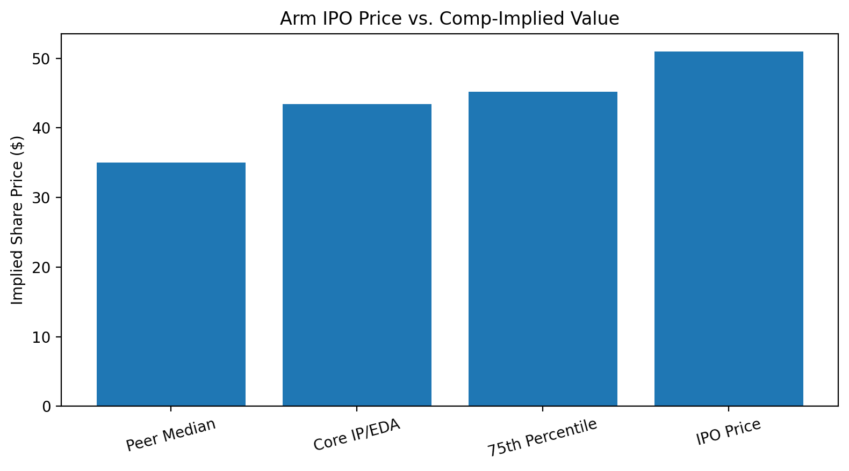
3. IPO Valuation Range
Comp-based fair value landed below the $51 offer price
Full peer median → ~$35/share
Core IP/EDA reference → ~$43/share
75th percentile → ~$45/share
$51 IPO price implied an 11–15% premium to the most relevant reference range.
Conclusion: aggressive / premium-priced, but not irrational.
Sam Felix | Arm IPO Valuation & Strategy Analysis | August 2026

Slide 5
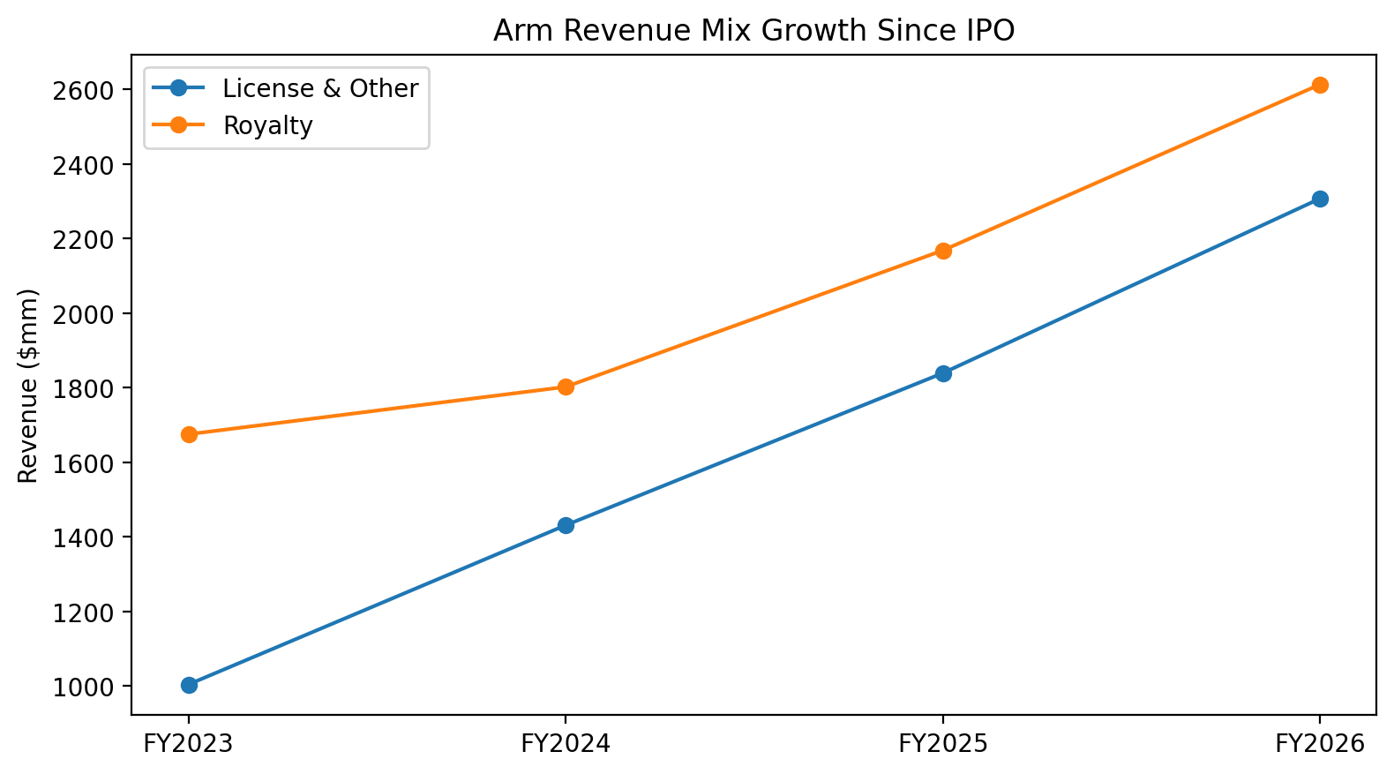
4. Post-IPO Operating Validation
Both license and royalty revenue expanded materially
22.5%
Revenue CAGR
32.0%
License CAGR
16.0%
Royalty CAGR
19.9%
Net Income CAGR
FY2023 → FY2026
Underlying growth supports a meaningful part of the IPO premium.
Sam Felix | Arm IPO Valuation & Strategy Analysis | August 2026

Slide 6
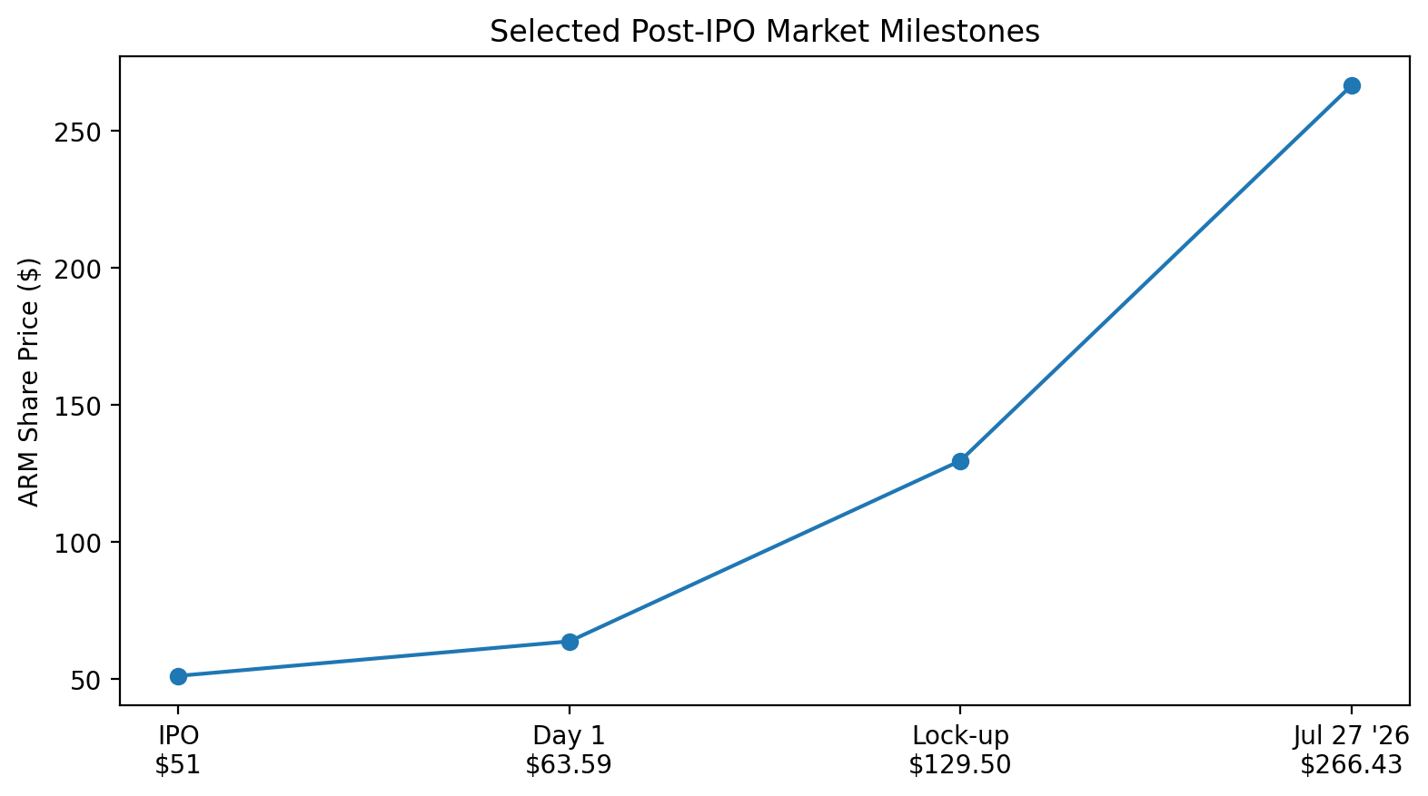
5. Market Performance & Strategic Read-Through
Strong re-rating, but high valuation remains sensitive to execution
First-day close: $63.59 (+24.7%)
Lock-up expiry close (Mar. 2024): $129.50
Recent July 2026 reference: $266.43
Q1 FY2027 revenue beat expectations, but shares fell ~7% after hours on smartphone royalty caution.
Premium valuation requires consistently strong AI/data-center and royalty execution.
Sam Felix | Arm IPO Valuation & Strategy Analysis | August 2026

Slide 7
6.5 Valuation Evolution: IPO vs. Current
Total return decomposes into earnings growth and multiple expansion
5.34x
Total Return
1.67x
From EPS Growth
3.20x
From P/E Expansion
3.11x
EV/Revenue Confirms
Arm's 5.34x total shareholder return since IPO splits exactly into 1.67x from EPS growth and 3.20x from P/E expansion.
EV/Revenue expanded a closely matching 3.11x — two independent multiples confirming the same re-rating.
Multiple re-rating contributed roughly twice as much to the stock's return as underlying earnings growth.
The 11–15% IPO premium looks conservative in hindsight — not aggressive — relative to today's multiple.
Today's shares carry meaningfully more re-rating risk than the IPO price did.
Sam Felix | Arm IPO Valuation & Strategy Analysis | August 2026

Slide 8
7. Final Verdict
Successful premium IPO; long-term justification depends on execution
$43–$45
Comp-Based Range
$51
IPO Price
$63.59
First-Day Close
22.5%
FY23–FY26 Revenue CAGR
Arm was premium-priced by roughly 11–15% versus the closest public-market references.
SoftBank still achieved a successful transaction: strong pricing plus substantial aftermarket demand.
Post-IPO revenue and earnings grew substantially (1.67x) — but the market re-rated the multiple even further (3.20x).
Key risks: valuation re-rating risk, smartphone concentration, Arm China, RISC-V, SoftBank control, and data-center execution.
The 11–15% IPO premium looks conservative in hindsight, not aggressive, relative to where the market ultimately priced Arm.
Sam Felix | Arm IPO Valuation & Strategy Analysis | August 2026

